Slide 1

Chapter 2
Application Layer
A note on the use of these PowerPoint slides:
We’re making these slides freely available to all (faculty, students, readers). They’re in PowerPoint form so you see the animations; and can add, modify, and delete slides (including this one) and slide content to suit your needs. They obviously represent a lot of work on our part. In return for use, we only ask the following:
If you use these slides (e.g., in a class) that you mention their source (after all, we’d like people to use our book!)
If you post any slides on a www site, that you note that they are adapted from (or perhaps identical to) our slides, and note our copyright of this material.
For a revision history, see the slide note for this page.
Thanks and enjoy! JFK/KWR
All material copyright 1996-2025
J.F Kurose and K.W. Ross, All Rights Reserved
Computer Networking: A Top-Down Approach
9th edition
Jim Kurose, Keith Ross
Pearson, 2025
Notes:
Version 9.0: updated to 9th Edition, June 2025

Slide 2

Application layer: overview
video streaming and content distribution networks
socket programming with UDP and TCP
Principles of network applications
Web and HTTP
E-mail, SMTP, IMAP
The Domain Name System DNS

Slide 3
Application layer: overview
Our goals:
conceptual and implementation aspects of application-layer protocols
  transport-layer service models
  client-server paradigm
  peer-to-peer paradigm
learn about protocols by examining popular application-layer protocols and infrastructure
  HTTP
  SMTP, IMAP
  DNS
  video streaming systems, CDNs
programming network applications
  socket API

Slide 4
Some network apps
social media
Web
text messaging
e-mail
multi-user network games
streaming stored video (YouTube, Hulu, Netflix)
P2P file sharing
voice over IP
real-time video conferencing (e.g., Zoom)
Internet search
remote login
…
Q: your favorites?

Slide 5
















Creating a network app
application
transport
network
data link
physical
write programs that:
run on (different) end systems
communicate over network
e.g., web server software communicates with browser software
no need to write software for network-core devices
network-core devices do not run user applications
applications on end systems allows for rapid app development, propagation
mobile network
national or global ISP
local or regional ISP
home network
content
provider
network
application
transport
network
data link
physical
application
transport
network
data link
physical
datacenter
network
enterprise
network

Slide 6
Client-server paradigm
server:
always-on host
permanent IP address
often in data centers, for scaling
clients:
contact, communicate with server
may be intermittently connected
may have dynamic IP addresses
do not communicate directly with each other
examples: HTTP, IMAP, FTP
mobile network
national or global ISP
local or regional ISP
home network
content
provider
network
datacenter
network
enterprise
network

Slide 7
Peer-peer architecture
no always-on server
arbitrary end systems directly communicate
peers request service from other peers, provide service in return to other peers
  self scalability – new peers bring new service capacity, as well as new service demands
peers are intermittently connected and change IP addresses
  complex management
example: P2P file sharing [BitTorrent]
mobile network
national or global ISP
local or regional ISP
home network
content
provider
network
datacenter
network
enterprise
network

Slide 8
Processes communicating
process: program running within a host
within same host, two processes communicate using inter-process communication (defined by OS)
processes in different hosts communicate by exchanging messages
clients, servers
client process: process that initiates communication
server process: process that waits to be contacted
note: applications with P2P architectures have client processes & server processes

Slide 9

Sockets
process sends/receives messages to/from its socket
socket analogous to door
  sending process shoves message out door
  sending process relies on transport infrastructure on other side of door to deliver message to socket at receiving process
  two sockets involved: one on each side
application
socket
application
controlled by
app developer
process
process
transport
transport
network
network
controlled
by OS
link
Internet
link
physical
physical

Slide 10
Addressing processes
to receive messages, process must have identifier
host device has unique 32-bit IP address
Q: does IP address of host on which process runs suffice for identifying the process?
identifier includes both IP address and port numbers associated with process on host.
example port numbers:
  HTTP server: 80
  mail server: 25
to send HTTP message to gaia.cs.umass.edu web server:
  IP address: 128.119.245.12
  port number: 80
more shortly…
  A: no, many processes can be running on same host

Slide 11
An application-layer protocol defines:
types of messages exchanged,
  e.g., request, response
message syntax:
  what fields in messages & how fields are delineated
message semantics
  meaning of information in fields
rules for when and how processes send & respond to messages
open protocols:
defined in RFCs, everyone has access to protocol definition
allows for interoperability
e.g., HTTP, SMTP
proprietary protocols:
e.g., Zoom

Slide 12
What transport service does an app need?
data integrity
some apps (e.g., file transfer, web transactions) require 100% reliable data transfer
other apps (e.g., audio) can tolerate some loss
throughput
some apps (e.g., multimedia) require minimum amount of throughput to be “effective”
other apps (“elastic apps”) make use of whatever throughput they get
timing
some apps (e.g., Internet telephony, interactive games) require low delay to be “effective”
security
encryption, data integrity, …

Slide 13
Transport service requirements: common apps
application
file transfer/download
e-mail
Web documents
real-time audio/video
streaming audio/video
interactive games
text messaging
data loss
no loss
no loss
no loss
loss-tolerant
loss-tolerant
loss-tolerant
no loss
throughput
elastic
elastic
elastic
audio: 5Kbps-1Mbps
video:10Kbps-5Mbps
same as above
Kbps+
elastic
time sensitive?
no
no
no
yes, 10’s msec
yes, few secs
yes, 10’s msec
yes and no

Slide 14
Internet transport protocols services
TCP service:
reliable transport between sending and receiving process
flow control: sender won’t overwhelm receiver
congestion control: throttle sender when network overloaded
connection-oriented: setup required between client and server processes
does not provide: timing, minimum throughput guarantee, security
UDP service:
unreliable data transfer between sending and receiving process
does not provide: reliability, flow control, congestion control, timing, throughput guarantee, security, or connection setup.
Q: why bother? Why is there a UDP?

Slide 15
Internet applications, and transport protocols
application
layer protocol
FTP [RFC 959]
SMTP [RFC 5321]
HTTP [RFC 7230, 9110]
SIP [RFC 3261], RTP [RFC 3550], or proprietary HTTP [RFC 7230], DASH
WOW, FPS (proprietary)
application
file transfer/download
e-mail
Web documents
Internet telephony
streaming audio/video
interactive games
transport protocol
TCP
TCP
TCP
TCP or UDP
TCP
UDP or TCP

Slide 16
Securing TCP
Vanilla TCP & UDP sockets:
no encryption
cleartext passwords sent into socket traverse Internet in cleartext (!)
Transport Layer Security (TLS)
provides encrypted TCP connections
data integrity
end-point authentication
TLS implemented in application layer
apps use TLS libraries, that use TCP in turn
  cleartext sent into “socket” traverse Internet encrypted
  more: Chapter 8

Slide 17
Application layer: overview
video streaming and content distribution networks
socket programming with UDP and TCP
Principles of network applications
Web and HTTP
E-mail, SMTP, IMAP
The Domain Name System DNS

Slide 18
Web and HTTP
First, a quick review…
web page consists of objects, each of which can be stored on different Web servers
object can be HTML file, JPEG image, Java applet, audio file,…
web page consists of base HTML-file which includes several referenced objects, each addressable by a URL, e.g.,
www.someschool.edu/someDept/pic.gif
host name
path name

Slide 19

HTTP overview
HTTP: hypertext transfer protocol
Web’s application-layer protocol
client/server model:
  client: browser that requests, receives, (using HTTP protocol) and “displays” Web objects
  server: Web server sends (using HTTP protocol) objects in response to requests
HTTP request
PC running
Firefox browser
HTTP response
HTTP request
server running
Apache Web
server
HTTP response
iPhone running
Safari browser

Slide 20
HTTP overview (continued)
HTTP uses TCP:
client initiates TCP connection (creates socket) to server, port 80
server accepts TCP connection from client
HTTP messages (application-layer protocol messages) exchanged between browser (HTTP client) and Web server (HTTP server)
TCP connection closed
HTTP is “stateless”
server maintains no information about past client requests
aside
protocols that maintain “state” are complex!
past history (state) must be maintained
if server/client crashes, their views of “state” may be inconsistent, must be reconciled

Slide 21
HTTP connections: two types
Non-persistent HTTP
TCP connection opened
at most one object sent over TCP connection
TCP connection closed
downloading multiple objects required multiple connections
Persistent HTTP
TCP connection opened to a server
multiple objects can be sent over single TCP connection between client, and that server
TCP connection closed

Slide 22
Non-persistent HTTP: example
User enters URL:
www.someSchool.edu/someDepartment/home.index
(containing text, references to 10 jpeg images)
1a. HTTP client initiates TCP connection to HTTP server (process) at www.someSchool.edu on port 80
1b. HTTP server at host www.someSchool.edu waiting for TCP connection at port 80 “accepts” connection, notifying client
2. HTTP client sends HTTP request message (containing URL) into TCP connection socket. Message indicates that client wants object someDepartment/home.index
3. HTTP server receives request message, forms response message containing requested object, and sends message into its socket
time

Slide 23
Non-persistent HTTP: example (cont.)
User enters URL:
www.someSchool.edu/someDepartment/home.index
(containing text, references to 10 jpeg images)
4. HTTP server closes TCP connection.
5. HTTP client receives response message containing html file, displays html. Parsing html file, finds 10 referenced jpeg objects
6. Steps 1-5 repeated for each of 10 jpeg objects
time

Slide 24
Non-persistent HTTP: response time
RTT (definition): time for a small packet to travel from client to server and back
HTTP response time (per object):
one RTT to initiate TCP connection
one RTT for HTTP request and first few bytes of HTTP response to return
object/file transmission time
initiate TCP
connection
RTT
request file
RTT
time to
transmit
file
file received
time
time
Non-persistent HTTP response time = 2RTT+ file transmission time

Slide 25
Persistent HTTP (HTTP 1.1)
Non-persistent HTTP issues:
requires 2 RTTs per object
OS overhead for each TCP connection
browsers often open multiple parallel TCP connections to fetch referenced objects in parallel
Persistent HTTP (HTTP1.1):
server leaves connection open after sending response
subsequent HTTP messages between same client/server sent over open connection
client sends requests as soon as it encounters a referenced object
as little as one RTT for all the referenced objects (cutting response time in half)

Slide 26
HTTP request message
two types of HTTP messages: request, response
HTTP request message:
  ASCII (human-readable format)
carriage return character
request line (GET, POST,
HEAD commands)
line-feed character
GET /index.html HTTP/1.1\r\n
Host: www-net.cs.umass.edu\r\n
User-Agent: Mozilla/5.0 (Macintosh; Intel Mac OS X 10.15; rv:80.0) Gecko/20100101 Firefox/80.0 \r\n
Accept: text/html,application/xhtml+xml\r\n
Accept-Language: en-us,en;q=0.5\r\n
Accept-Encoding: gzip,deflate\r\n
Connection: keep-alive\r\n
\r\n
header
lines
carriage return, line feed at start of line indicates end of header lines
* Check out the online interactive exercises for more examples: http://gaia.cs.umass.edu/kurose_ross/interactive/

Slide 27
HTTP request message: general format
method
sp
URL
sp
version
cr
lf
request
line
header field name
value
cr
lf
~
~
header
lines
~
~
header field name
value
cr
lf
cr
lf
~
entity body
~
body
~
~

Slide 28
Other HTTP request messages
POST method:
web page often includes form input
user input sent from client to server in entity body of HTTP POST request message
HEAD method:
requests headers (only) that would be returned if specified URL were requested with an HTTP GET method.
PUT method:
uploads new file (object) to server
completely replaces file that exists at specified URL with content in entity body of POST HTTP request message
GET method (for sending data to server):
include user data in URL field of HTTP GET request message (following a ‘?’):
www.somesite.com/animalsearch?monkeys&banana

Slide 29
HTTP response message
status line (protocol
status code status phrase)
HTTP/1.1 200 OK
Date: Tue, 08 Sep 2020 00:53:20 GMT
Server: Apache/2.4.6 (CentOS) OpenSSL/1.0.2k-fips PHP/7.4.9 mod_perl/2.0.11 Perl/v5.16.3
Last-Modified: Tue, 01 Mar 2016 18:57:50 GMT
ETag: "a5b-52d015789ee9e"
Accept-Ranges: bytes
Content-Length: 2651
Content-Type: text/html; charset=UTF-8
\r\n
data data data data data ...
header
lines
data, e.g., requested
HTML file
* Check out the online interactive exercises for more examples: http://gaia.cs.umass.edu/kurose_ross/interactive/

Slide 30
HTTP response status codes
status code appears in 1st line in server-to-client response message.
some sample codes:
200 OK
  request succeeded, requested object later in this message
301 Moved Permanently
  requested object moved, new location specified later in this message (in Location: field)
400 Bad Request
  request msg not understood by server
404 Not Found
  requested document not found on this server
505 HTTP Version Not Supported

Slide 31
Trying out HTTP (client side) for yourself
1. netcat to your favorite Web server:
% nc -c -v gaia.cs.umass.edu 80 (for Mac)
>ncat –C gaia.cs.umass.edu 80 (for Windows)
opens TCP connection to port 80 (default HTTP server port) at gaia.cs.umass.edu.
anything typed in will be sent to port 80 at gaia.cs.umass.edu
2. type in a GET HTTP request:
GET /kurose_ross/interactive/index.php HTTP/1.1
Host: gaia.cs.umass.edu
by typing this in (hit carriage return twice), you send this minimal (but complete) GET request to HTTP server
3. look at response message sent by HTTP server!
(or use Wireshark to look at captured HTTP request/response)

Slide 32

Maintaining user/server state: cookies
Recall: HTTP GET/response interaction is stateless
no notion of multi-step exchanges of HTTP messages to complete a Web “transaction”
  no need for client/server to track “state” of multi-step exchange
  all HTTP requests are independent of each other
  no need for client/server to “recover” from a partially-completed-but-never-completely-completed transaction
a stateful protocol: client makes two changes to X, or none at all
X
lock data record X
X
OK
update X X’
X’
OK
t’
update X X’’
OK
X’’
unlock X
OK
X’’
time
time
Q: what happens if network connection or client crashes at t’ ?
Notes:
t’

Slide 33
Maintaining user/server state: cookies
Web sites and client browser use cookies to maintain some state between transactions
four components:
  1) cookie header line of HTTP response message
  2) cookie header line in next HTTP request message
  3) cookie file kept on user’s host, managed by user’s browser
  4) back-end database at Web site
Example:
Susan uses browser on laptop, visits specific e-commerce site for first time
when initial HTTP requests arrives at site, site creates:
  unique ID (aka “cookie”)
  entry in backend database for ID
subsequent HTTP requests from Susan to this site will contain cookie ID value, allowing site to “identify” Susan
Notes:
t’

Slide 34
Maintaining user/server state: cookies
client
Amazon server
ebay 8734
usual HTTP request msg
Amazon server
creates ID
1678 for user
cookie file
usual HTTP response
set-cookie: 1678
backend
database
create
entry
ebay 8734
amazon 1678
usual HTTP request msg
cookie: 1678
cookie-
specific
action
access
usual HTTP response msg
one week later:
access
ebay 8734
amazon 1678
usual HTTP request msg
cookie: 1678
cookie-
specific
action
usual HTTP response msg
time
time
Notes:
t’

Slide 35
HTTP cookies: comments
aside
What cookies can be used for:
authorization
shopping carts
recommendations
user session state (Web e-mail)
cookies and privacy:
cookies permit sites to learn a lot about you on their site.
third party persistent cookies (tracking cookies) allow common identity (cookie value) to be tracked across multiple web sites
Challenge: How to keep state?
at protocol endpoints: maintain state at sender/receiver over multiple transactions
in messages: cookies in HTTP messages carry state
Notes:
t’

Slide 36
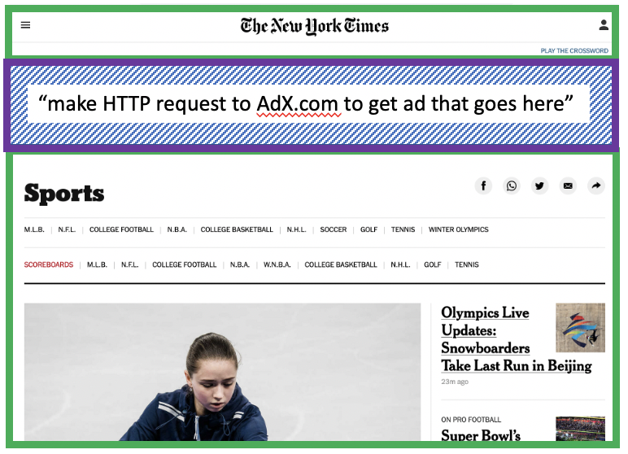
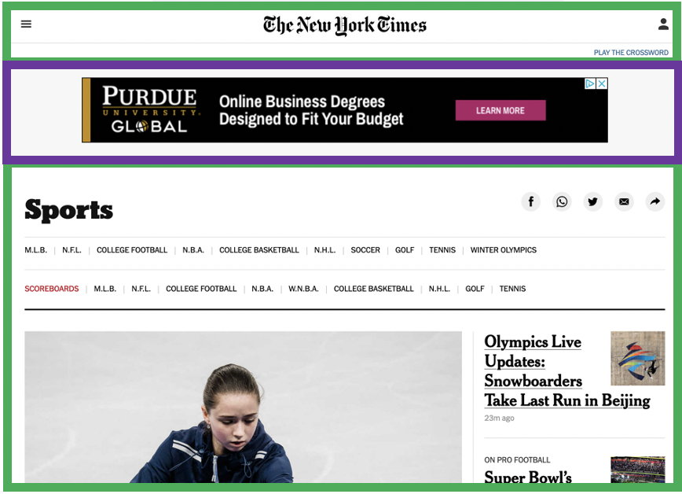


Example: displaying a NY Times web page
1
GET base html file from nytimes.com
2
fetch ad from AdX.com
nytimes.com
4
5
HTTP GET
1
2
HTTP reply
7
display composed page
3
4
6
5
NY times page with embedded ad displayed
AdX.com

Slide 37
Cookies: tracking a user’s browsing behavior
1634: sports, 2/15/22
nytimes.com (sports)
“first party” cookie – from website you chose to visit (provides base html file)
HTTP
GET
HTTP reply
Set cookie: 1634
HTTP GET
Referrer: NY Times Sports
4
5
7493: NY Times sports, 2/15/22
“third party” cookie – from website you did not choose to visit
HTTP reply
NY Times: 1634
Set cookie: 7493
AdX.com
AdX: 7493

Slide 38
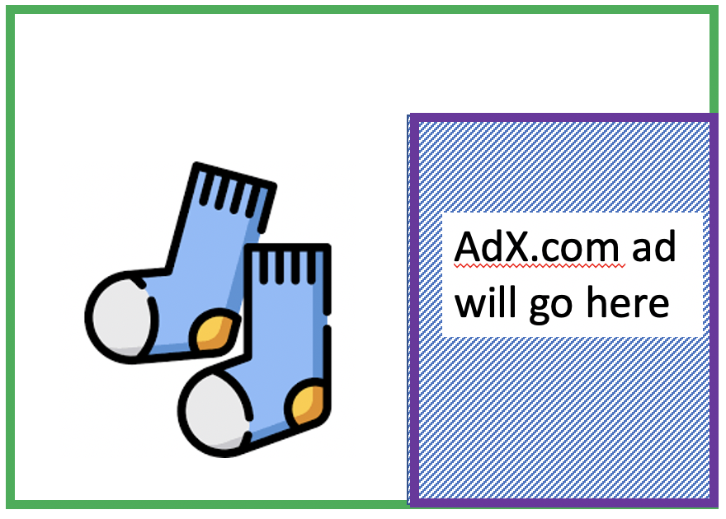
Cookies: tracking a user’s browsing behavior
1634: sports, 2/15/22
nytimes.com
AdX:
tracks my web browsing over sites with AdX ads
can return targeted ads based on browsing history
socks.com
HTTP reply
2
HTTP GET
1
HTTP GET
Referrer: socks.com, cookie: 7493
4
7493: NY Times sports, 2/15/22
5
7493: socks.com, 2/16/22
HTTP reply
NY Times: 1634
Set cookie: 7493
AdX.com
AdX: 7493

Slide 39

Cookies: tracking a user’s browsing behavior (one day later)
1634: sports, 2/15/22
1634: arts, 2/17/22
nytimes.com (arts)
socks.com
HTTP
GET
HTTP reply
cookie: 1634
Set cookie: 1634
HTTP GET
Referrer: nytimes.com, cookie: 7493
4
7493: NY Times sports, 2/15/22
5
7493: socks.com, 2/16/22
HTTP reply
7493: NY Times arts, 2/15/22
NY Times: 1634
Set cookie: 7493
AdX.com
AdX: 7493
Returned ad for socks!

Slide 40
Cookies: tracking a user’s browsing behavior
Cookies can be used to:
track user behavior on a given website (first party cookies)
track user behavior across multiple websites (third party cookies) without user ever choosing to visit tracker site (!)
tracking may be invisible to user:
  rather than displayed ad triggering HTTP GET to tracker, could be an invisible link
third party tracking via cookies:
disabled by default in Firefox, Safari browsers
to be disabled in Chrome browser in 2023

Slide 41
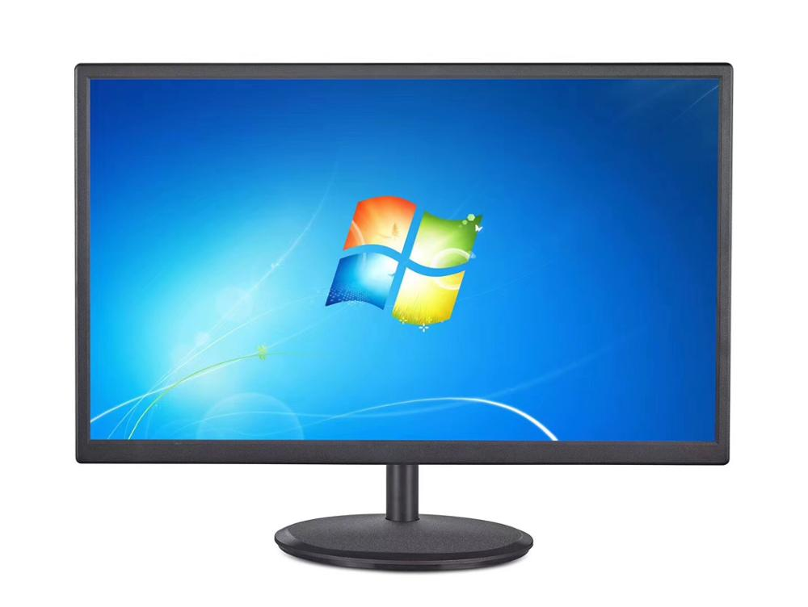
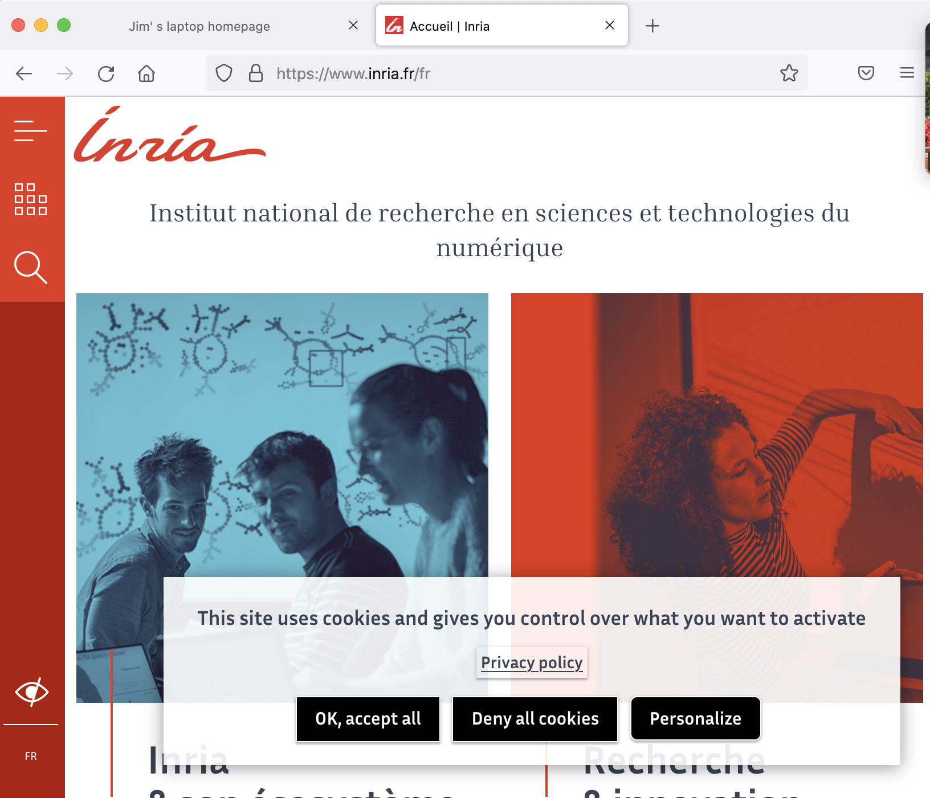
GDPR (EU General Data Protection Regulation) and cookies
“Natural persons may be associated with online identifiers […] such as internet protocol addresses, cookie identifiers or other identifiers […].
This may leave traces which, in particular when combined with unique identifiers and other information received by the servers, may be used to create profiles of the natural persons and identify them.”
GDPR, recital 30 (May 2018)
when cookies can identify an individual, cookies are considered personal data, subject to GDPR personal data regulations
User has explicit control over whether or not cookies are allowed

Slide 42

Web caches
Goal: satisfy client requests without involving origin server
user configures browser to point to a (local) Web cache
browser sends all HTTP requests to cache
  if object in cache: cache returns object to client
  else cache requests object from origin server, caches received object, then returns object to client
Web
cache
HTTP request
HTTP request
client
HTTP response
HTTP response
origin
server
HTTP request
HTTP response
client
Notes:
t’

Slide 43


Web caches (aka proxy servers)
Web cache acts as both client and server
  server for original requesting client
  client to origin server
Why Web caching?
reduce response time for client request
  cache is closer to client
reduce traffic on an institution’s access link
Internet is dense with caches
  enables “poor” content providers to more effectively deliver content
server tells cache about object’s allowable caching in response header:
Notes:
re: poor content providers – like in real-estate, location is everything. servers want to be close to clients.

Slide 44
Browser caching: Conditional GET
client
server
Goal: don’t send object if browser has up-to-date cached version
  no object transmission delay (or use of network resources)
client: specify date of browser-cached copy in HTTP request
  If-modified-since: <date>
server: response contains no object if browser-cached copy is up-to-date:
  HTTP/1.0 304 Not Modified
HTTP request msg
If-modified-since: <date>
object
not
modified
before
<date>
HTTP response
HTTP/1.0
304 Not Modified
HTTP request msg
If-modified-since: <date>
object
modified
after
<date>
HTTP response
HTTP/1.0 200 OK
<data>
Notes:
t’

Slide 45
HTTP/2
Key goal: decreased delay in multi-object HTTP requests
HTTP1.1: introduced multiple, pipelined GETs over single TCP connection
server responds in-order (FCFS: first-come-first-served scheduling) to GET requests
with FCFS, small object may have to wait for transmission (head-of-line (HOL) blocking) behind large object(s)
loss recovery (retransmitting lost TCP segments) stalls object transmission
Notes:
t’

Slide 46
HTTP/2
Key goal: decreased delay in multi-object HTTP requests
HTTP/2: [RFC 7540, 2015] increased flexibility at server in sending objects to client:
methods, status codes, most header fields unchanged from HTTP 1.1
transmission order of requested objects based on client-specified object priority (not necessarily FCFS)
push unrequested objects to client
divide objects into frames, schedule frames to mitigate HOL blocking
Notes:
t’

Slide 47
HTTP/2: mitigating HOL blocking
HTTP 1.1: client requests 1 large object (e.g., video file) and 3 smaller objects
server
GET O₄
GET O₃
GET O₂
GET O₁
object data requested
client
O₁
O₂
O₁
O₃
O₂
O₃
O₄
O₄
objects delivered in order requested: O₂, O₃, O₄ wait behind O₁
Notes:
t’

Slide 48
HTTP/2: mitigating HOL blocking
HTTP/2: objects divided into frames, frame transmission interleaved
server
GET O₄
GET O₃
GET O₂
GET O₁
object data requested
client
O₂
O₄
O₃
O₁
O₂
O₃
O₄
O₁
O₂, O₃, O₄ delivered quickly, O₁ slightly delayed
Notes:
shortest job first: decreased average delay!

Slide 49
HTTP/2 to HTTP/3
HTTP/2 over single TCP connection means:
recovery from packet loss still stalls all object transmissions
  as in HTTP 1.1, browsers have incentive to open multiple parallel TCP connections to reduce stalling, increase overall throughput
no security over vanilla TCP connection
HTTP/3: adds security, per object error- and congestion-control (more pipelining) over UDP
Notes:
t’

Slide 50
QUIC: Quick UDP Internet Connections
application-layer protocol, on top of UDP
  increase performance of HTTP
  deployed on many Google servers, apps (Chrome, mobile YouTube app)
HTTP/2
HTTP/2 (slimmed)
Application
HTTP/3
TLS
QUIC
Transport
TCP
UDP
Network
IP
IP
HTTP/2 over TCP
HTTP/2 over QUIC over UDP

Slide 51
QUIC: Quick UDP Internet Connections
adopts approaches we’ll study in chapter for connection establishment, error control, congestion control
  error and congestion control: “Readers familiar with TCP’s loss detection and congestion control will find algorithms here that parallel well-known TCP ones.” [from QUIC specification]
  connection establishment: reliability, congestion control, authentication, encryption, state established in one RTT

Slide 52
QUIC: Connection establishment
TCP handshake
(transport layer)
QUIC
1RTT handshake
data
TLS handshake
(security)
data
TCP (reliability, congestion control state) + TLS (authentication, crypto state)
2 serial handshakes
QUIC: reliability, congestion control, authentication, crypto state
1 handshake

Slide 53

QUIC: 0-RTT Connection establishment
TLS session ticket sent by server, cached at client
data
end of first QUIC connection
Client uses last session ticket for encryption, authentication for new connection
0 RTT handshake delay
start of second QUIC connection
data

Slide 54
Application layer: overview
video streaming and content distribution networks
socket programming with UDP and TCP
Principles of network applications
Web and HTTP
E-mail, SMTP, IMAP
The Domain Name System DNS

Slide 55
E-mail
user
agent
Three major components:
user agents
mail servers
simple mail transfer protocol: SMTP
User Agent
a.k.a. “mail reader”
composing, editing, reading mail messages
e.g., Outlook, iPhone mail client
outgoing, incoming messages stored on server
mail
server
user
agent
SMTP
mail
server
user
agent
SMTP
SMTP
user
agent
mail
server
user
agent
user
agent
outgoing
message queue
user mailbox

Slide 56
E-mail: mail servers
user
agent
mail servers:
mailbox contains incoming messages for user
message queue of outgoing (to be sent) mail messages
SMTP protocol between mail servers to send email messages
client: sending mail server
“server”: receiving mail server
mail
server
user
agent
SMTP
mail
server
user
agent
SMTP
SMTP
user
agent
mail
server
user
agent
user
agent
outgoing
message queue
user mailbox

Slide 57
SMTP RFC (5321)
“client”
SMTP server
“server”
SMTP server
uses TCP to reliably transfer email message from client (mail server initiating connection) to server, port 25
  direct transfer: sending server (acting like client) to receiving server
three phases of transfer
  SMTP handshaking (greeting)
  SMTP transfer of messages
  SMTP closure
command/response interaction (like HTTP)
  commands: ASCII text
  response: status code and phrase
initiate TCP
connection
RTT
TCP connection
initiated
220
SMTP handshaking
HELO
250 Hello
SMTP transfers
time

Slide 58


Scenario: Alice sends e-mail to Bob
1) Alice uses UA to compose e-mail message “to” bob@someschool.edu
4) SMTP client sends Alice’s message over the TCP connection
2) Alice’s UA sends message to her mail server using SMTP; message placed in message queue
5) Bob’s mail server places the message in Bob’s mailbox
3) client side of SMTP at mail server opens TCP connection with Bob’s mail server
6) Bob invokes his user agent to read message
user
agent
mail
server
user
agent
1
mail
server
2
3
6
4
Alice’s mail server
5
Bob’s mail server

Slide 59
Retrieving email: mail access protocols
user
agent
e-mail access
protocol
user
agent
SMTP
SMTP
(e.g., IMAP, HTTP)
sender’s e-mail
server
receiver’s e-mail
server
SMTP: delivery/storage of e-mail messages to receiver’s server
mail access protocol: retrieval from server
  IMAP: Internet Mail Access Protocol [RFC 3501]: messages stored on server, IMAP provides retrieval, deletion, folders of stored messages on server
HTTP: gmail, Hotmail, Yahoo!Mail, etc. provides web-based interface on top of STMP (to send), IMAP (or POP) to retrieve e-mail messages

Slide 60
Application Layer: Overview
video streaming and content distribution networks
socket programming with UDP and TCP
Principles of network applications
Web and HTTP
E-mail, SMTP, IMAP
The Domain Name System DNS

Slide 61
DNS: Domain Name System
people: many identifiers:
  SSN, name, passport #
Internet hosts, routers:
  IP address (32 bit) - used for addressing datagrams
  “name”, e.g., cs.umass.edu - used by humans
Q: how to map between IP address and name, and vice versa ?
Domain Name System (DNS):
distributed database implemented in hierarchy of many name servers
application-layer protocol: hosts, DNS servers communicate to resolve names (address/name translation)
  note: core Internet function, implemented as application-layer protocol
  complexity at network’s “edge”

Slide 62
DNS: services, structure
DNS services:
hostname-to-IP-address translation
host aliasing
  canonical, alias names
mail server aliasing
load distribution
  replicated Web servers: many IP addresses correspond to one name
Q: Why not centralize DNS?
single point of failure
traffic volume
distant centralized database
maintenance
A: doesn‘t scale!
Comcast DNS servers alone: 600B DNS queries/day
Akamai DNS servers alone: 2.2T DNS queries/day

Slide 63

Thinking about the DNS
humongous distributed database:
~ billion records, each simple
handles many trillions of queries/day:
many more reads than writes
performance matters: almost every Internet transaction interacts with DNS - msecs count!
organizationally, physically decentralized:
millions of different organizations responsible for their records
“bulletproof”: reliability, security

Slide 64
DNS: a distributed, hierarchical database
Root DNS Servers
Root
…
…
.com DNS servers
.org DNS servers
.edu DNS servers
Top Level Domain
…
…
…
…
yahoo.com
DNS servers
amazon.com
DNS servers
pbs.org
DNS servers
nyu.edu
DNS servers
umass.edu
DNS servers
Authoritative
Client wants IP address for www.amazon.com; 1st approximation:
client queries root server to find .com DNS server
client queries .com DNS server to get amazon.com DNS server
client queries amazon.com DNS server to get IP address for www.amazon.com

Slide 65
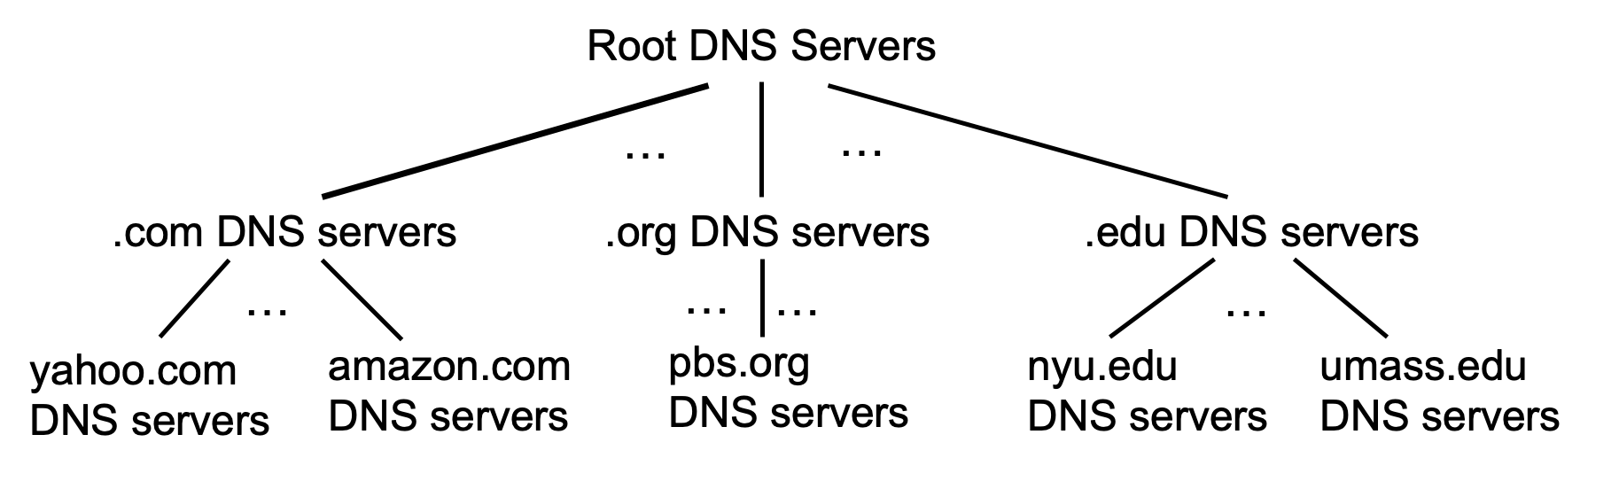
DNS: root name servers
official, contact-of-last-resort by name servers that can not resolve name

Slide 66
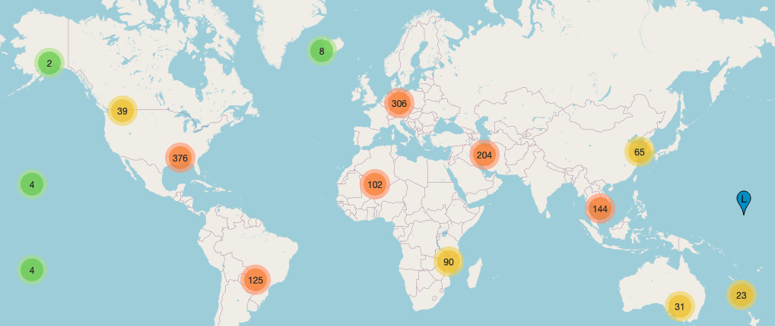
DNS: root name servers
official, contact-of-last-resort by name servers that can not resolve name
incredibly important Internet function
  Internet couldn’t function without it!
  DNSSEC – provides security (authentication, message integrity)
ICANN (Internet Corporation for Assigned Names and Numbers) manages root DNS domain
ICANN (Internet Corporation for Assigned Names and Numbers) manages root DNS domain
13 logical root name “servers” worldwide; each “server,” replicated many times

Slide 67
Top-Level Domain, and authoritative servers
Top-Level Domain (TLD) servers:
  responsible for .com, .org, .net, .edu, .aero, .jobs, .museums, and all top-level country domains, e.g.: .cn, .uk, .fr, .ca, .jp
  Network Solutions: authoritative registry for .com, .net TLD
  Educause: .edu TLD
authoritative DNS servers:
  organization’s own DNS server(s), providing authoritative hostname to IP mappings for organization’s named hosts
  can be maintained by organization or service provider

Slide 68
Local DNS name servers
when host makes DNS query, it is sent to its local DNS server
  Local DNS server returns reply, answering:
    from its local cache of recent name-to-address translation pairs (possibly out of date!)
    forwarding request into DNS hierarchy for resolution
  each ISP has local DNS name server; to find yours:
    MacOS: % scutil --dns
    Windows: >ipconfig /all
local DNS server doesn’t strictly belong to hierarchy

Slide 69
DNS name resolution: iterated query
root DNS server
Example: host at engineering.nyu.edu wants IP address for gaia.cs.umass.edu
2
3
TLD DNS server
Iterated query:
contacted server replies with name of server to contact
“I don’t know this name, but ask this server”
1
4
8
5
requesting host at
engineering.nyu.edu
local DNS server
dns.nyu.edu
gaia.cs.umass.edu
7
6
authoritative DNS server
dns.cs.umass.edu

Slide 70
DNS name resolution: recursive query
root DNS server
Example: host at engineering.nyu.edu wants IP address for gaia.cs.umass.edu
2
3
7
6
Recursive query:
puts burden of name resolution on contacted name server
heavy load at upper levels of hierarchy?
1
TLD DNS server
8
requesting host at
engineering.nyu.edu
local DNS server
dns.nyu.edu
5
4
gaia.cs.umass.edu
authoritative DNS server
dns.cs.umass.edu

Slide 71
Caching DNS Information
once (any) name server learns mapping, it caches mapping, and immediately returns a cached mapping in response to a query
  caching improves response time
  cache entries timeout (disappear) after some time (TTL)
  TLD servers typically cached in local name servers
cached entries may be out-of-date
  if named host changes IP address, may not be known Internet-wide until all TTLs expire!
  best-effort name-to-address translation!

Slide 72
DNS records
DNS: distributed database storing resource records (RR)
RR format: (name, value, type, ttl)
type=A
  name is hostname
  value is IP address
type=CNAME
  name is alias name for some “canonical” (the real) name
  www.ibm.com is really servereast.backup2.ibm.com
  value is canonical name
type=NS
  name is domain (e.g., foo.com)
  value is hostname of authoritative name server for this domain
type=MX
  value is name of SMTP mail server associated with name

Slide 73
DNS protocol messages
DNS query and reply messages, both have same format:
2 bytes
2 bytes
message header:
identification: 16 bit # for query, reply to query uses same #
flags:
  query or reply
  recursion desired
  recursion available
  reply is authoritative
identification
flags
# questions
# answer RRs
# authority RRs
# additional RRs
questions (variable # of questions)
answers (variable # of RRs)
authority (variable # of RRs)
additional info (variable # of RRs)

Slide 74
DNS protocol messages
DNS query and reply messages, both have same format:
2 bytes
2 bytes
identification
flags
# questions
# answer RRs
# authority RRs
# additional RRs
name, type fields for a query
questions (variable # of questions)
RRs in response to query
answers (variable # of RRs)
records for authoritative servers
authority (variable # of RRs)
additional “ helpful” info that may be used
additional info (variable # of RRs)

Slide 75
Getting your info into the DNS
example: new startup “Network Utopia”
register name networkuptopia.com at DNS registrar (e.g., Network Solutions)
  provide names, IP addresses of authoritative name server (primary and secondary)
  registrar inserts NS, A RRs into .com TLD server:
  (networkutopia.com, dns1.networkutopia.com, NS)
  (dns1.networkutopia.com, 212.212.212.1, A)
create authoritative server locally with IP address 212.212.212.1
  type A record for www.networkuptopia.com
  type MX record for networkutopia.com

Slide 76
DNS security
DDoS attacks
bombard root servers with traffic
  not successful to date
  traffic filtering
  local DNS servers cache IPs of TLD servers, allowing root server bypass
bombard TLD servers
  potentially more dangerous
Spoofing attacks
intercept DNS queries, returning bogus replies
  DNS cache poisoning
  RFC 4033: DNSSEC authentication services

Slide 77
Application layer: overview
P2P applications
video streaming and content distribution networks
socket programming with UDP and TCP
Principles of network applications
Web and HTTP
E-mail, SMTP, IMAP
The Domain Name System DNS

Slide 78




Video Streaming and CDNs: context
stream video traffic: major consumer of Internet bandwidth
  Netflix, YouTube, Amazon Prime: 80% of residential ISP traffic (2020)
challenge: scale - how to reach ~1B users?
challenge: heterogeneity
  different users have different capabilities (e.g., wired versus mobile; bandwidth rich versus bandwidth poor)
solution: distributed, application-level infrastructure

Slide 79

Multimedia: video
spatial coding example: instead of sending N values of same color (all purple), send only two values: color value (purple) and number of repeated values (N)
video: sequence of images displayed at constant rate
  e.g., 24 images/sec
digital image: array of pixels
  each pixel represented by bits
coding: use redundancy within and between images to decrease # bits used to encode image
  spatial (within image)
  temporal (from one image to next)
……………………..
……………….…….
frame i
temporal coding example: instead of sending complete frame at i+1, send only differences from frame i
frame i+1

Slide 80
Content distribution networks (CDNs)
challenge: how to stream content (selected from millions of videos) to hundreds of thousands of simultaneous users?
option 1: single, large “mega-server”
  single point of failure
  point of network congestion
  long (and possibly congested) path to distant clients
….quite simply: this solution doesn’t scale

Slide 81


Content distribution networks (CDNs)
challenge: how to stream content (selected from millions of videos) to hundreds of thousands of simultaneous users?
option 2: store/serve multiple copies of videos at multiple geographically distributed sites (CDN)
  enter deep: push CDN servers deep into many access networks
    close to users
    Akamai: 240,000 servers deployed
    in > 120 countries (2015)
  bring home: smaller number (10’s) of larger clusters in POPs near access nets
    used by Limelight

Slide 82
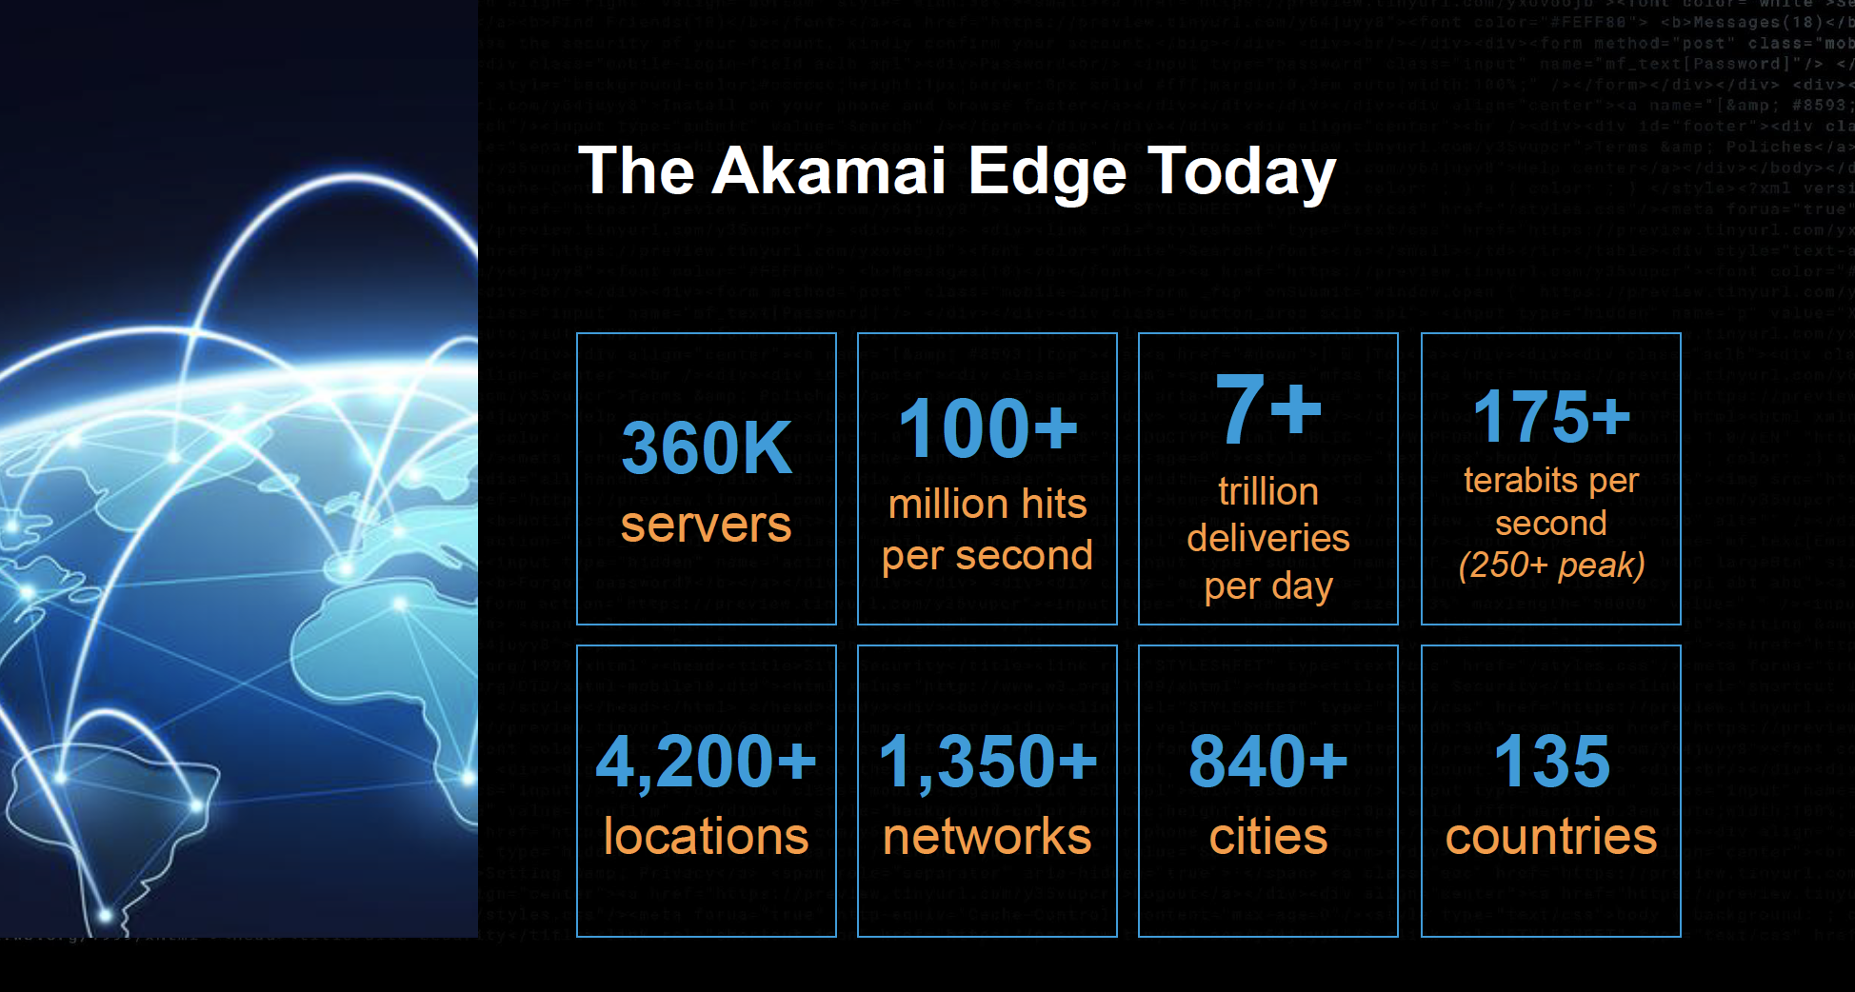
Akamai today:
Source: https://networkingchannel.eu/living-on-the-edge-for-a-quarter-century-an-akamai-retrospective-downloads/

Slide 83




How does Netflix work?
Netflix: stores copies of content (e.g., MADMEN) at its (worldwide) OpenConnect CDN nodes
subscriber requests content, service provider returns manifest
  using manifest, client retrieves content at highest supportable rate
  may choose different rate or copy if network path congested
…
…
…
manifest file
…
where’s Madmen?
…
…
Notes:
83
Akamai: 100,000+ servers in 1000+ clusters in 1000+ networks in 70+ countries serving trillions of requests a day.
How many people use Netflix?

Slide 84
Socket programming
goal: learn how to build client/server applications that communicate using sockets
socket: door between application process and end-end-transport protocol
application
socket
application
controlled by
app developer
process
process
transport
transport
network
network
controlled
by OS
link
Internet
link
physical
physical

Slide 85
Socket programming
  Two socket types for two transport services:
  UDP: unreliable datagram
  TCP: reliable, byte stream-oriented
  Application Example:
client reads a line of characters (data) from its keyboard and sends data to server
server receives the data and converts characters to uppercase
server sends modified data to client
client receives modified data and displays line on its screen

Slide 86
Client/server socket interaction: UDP
server (running on serverIP)
client
create socket:
create socket, port= x:
clientSocket =
socket(AF_INET,SOCK_DGRAM)
serverSocket =
socket(AF_INET,SOCK_DGRAM)
Create datagram with serverIP address
And port=x; send datagram via
clientSocket
read datagram from
serverSocket
write reply to
serverSocket
specifying
client address,
port number
read datagram from
clientSocket
close
clientSocket

Slide 87
Chapter 2: Summary
our study of network application layer is now complete!
application architectures
  client-server
  P2P
application service requirements:
  reliability, bandwidth, delay
Internet transport service model
  connection-oriented, reliable: TCP
  unreliable, datagrams: UDP
specific protocols:
  HTTP
  SMTP, IMAP
  DNS
  P2P: BitTorrent
video streaming, CDNs
socket programming:
TCP, UDP sockets

Slide 88
Chapter 2: Summary
Most importantly: learned about protocols!
Important themes:
typical client/server request/reply message exchange
centralized vs. decentralized
stateless vs. stateful
scalability
reliable vs. unreliable message transfer
“complexity at network edge”

